Slide 1
Credit Card Fraud Detection using Imbalanced Classification
Qalab E Abbas

Slide 2
Imbalanced Classification
A classification predictive modeling problem where the distribution of examples across the classes is not equal.
For example, we may collect measurements of flowers and have 80 examples of one flower species and 20 examples of a second flower species, and only these examples comprise our training dataset. This represents an example of an imbalanced classification problem. (Slight Imbalance)
In Credit Card Transaction dataset, percentage of non-fraudulent transaction is 99.83% against 0.017% fraudulent transactions.(Severe Imbalance)
Majority vs Minority Class

Slide 3


How to handle Imbalanced Data
Sampling to balance the class distribution
Techniques designed to change the class distribution in the training dataset are generally referred to as sampling methods as we are sampling an existing data sample.
Sampling techniques are simple and easy to implement.

Slide 4
Oversampling
Oversampling methods duplicate examples in the minority class or synthesize new examples from the examples in the minority class. Some of the more widely used and implemented oversampling methods include:
Random Oversampling
Synthetic Minority Oversampling Technique (SMOTE)
Borderline-SMOTE
Borderline Oversampling with SVM
Adaptive Synthetic Sampling (ADASYN)
Notes:
SMOTE first selects a minority class instance a at random and finds its k nearest minority class neighbors. The synthetic instance is then created by choosing one of the k nearest neighbors b at random and connecting a and b to form a line segment in the feature space. The synthetic instances are generated as a convex combination of the two chosen instances a and b.
A popular extension to SMOTE involves selecting those instances of the minority class that are misclassified, such as with a k-nearest neighbor classification model. We can then oversample just those difficult instances, providing more resolution only where it may be required.
Borderline-SMOTE where a SVM algorithm is used instead of a KNN to identify misclassified examples on the decision boundary
Another approach involves generating synthetic samples inversely proportional to the density of the examples in the minority class. That is, generate more synthetic examples in regions of the feature space where the density of minority examples is low, and fewer or none where the density is high. This modification to SMOTE is referred to as the Adaptive Synthetic Sampling Method, or ADASYN.
The KNN algorithm assumes that similar things exist in close proximity. In other words, similar things are near to each other.

Slide 5
Undersampling
Undersampling methods delete or select a subset of examples from the majority class. Some of the more widely used and implemented undersampling methods include:
Random Undersampling
Near Miss Undersampling
Condensed Nearest Neighbor Rule (CNN)
Tomek Links Undersampling
Edited Nearest Neighbors Rule (ENN)
One-Sided Selection (OSS)
Neighborhood Cleaning Rule (NCR)
Notes:
Near Miss refers to a collection of undersampling methods that select examples based on the distance of majority class examples to minority class examples. (Keep)
NearMiss-1: Majority class examples with minimum average distance to three closest minority class examples.
NearMiss-2: Majority class examples with minimum average distance to three furthest minority class examples.
NearMiss-3: Majority class examples with minimum distance to each minority class example.
CNN: When used for imbalanced classification, the store is comprised of all examples in the minority set and only examples from the majority set that cannot be classified correctly are added incrementally to the store. (Keep)
TL: is a rule that finds pairs of examples, one from each class; they together have the smallest Euclidean distance to each other in feature space. This means that in a binary classification problem with classes 0 and 1, a pair would have an example from each class and would be closest neighbors across the dataset.
-The procedure can be used to find all of those examples in the majority class that are closest to the minority class, then removed. These would be the ambiguous examples.
-From this definition, we see that instances that are in Tomek Links are either boundary instances or noisy instances. This is due to the fact that only boundary instances and noisy instances will have nearest neighbors, which are from the opposite class. (Del)
ENN: This rule involves using k = 3 nearest neighbors to locate those examples in a dataset that are misclassified and that are then removed before a k = 1 classification rule is applied. (Del).
OSS: OSS is an undersampling method resulting from the application of Tomek links followed by the application of US-CNN. Tomek links are used as an undersampling method and removes noisy and borderline majority class examples. [...] US-CNN aims to remove examples from the majority class that are distant from the decision border.
NCR: The approach involves first selecting all examples from the minority class. Then all of the ambiguous examples in the majority class are identified using the ENN rule and removed. Finally, a one-step version of CNN is used where those remaining examples in the majority class that are misclassified against the store are removed, but only if the number of examples in the majority class is larger than half the size of the minority class.

Slide 6
Hybrid Sampling
Oversampling and undersampling show great results on their own but sometimes combining the two sampling methods can improve the results even more.
There can be many combinations possible for Hybrid sampling .
Some of the famous combinations are
Random Undersampling and SMOTE
Tomek Links and SMOTE
Edited Nearest Neighbors Rule and SMOTE

Slide 7
ENSEMBLE SAMPLING
Mostly two sampling are used together for example using an undersampling technique along with one oversampling technique.
I tried using more than two techniques to see how it would effect the dataset and the result.

Slide 8
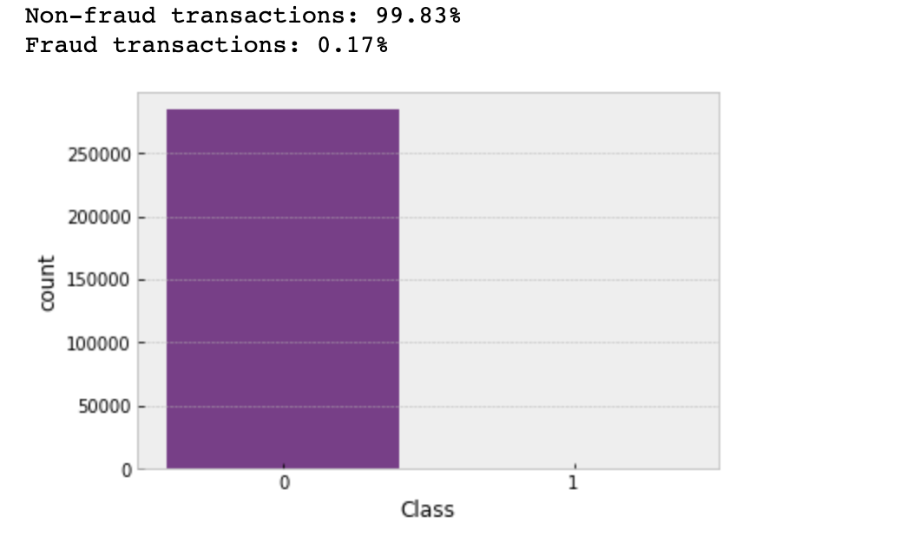
Credit Card Transaction Dataset
The datasets contain transactions made by credit cards in September 2013 by European cardholders.
This dataset presents transactions that occurred in two days, where we have 492 frauds out of 284,807 transactions. The dataset is highly unbalanced, the positive class (frauds) account for 0.172% of all transactions.

Slide 9

Performance Metrics
For Imbalanced Classification, Accuracy is not the best performance measure.
Instead, Precision and recall is used as performance measure in terms of F-Score.
F-Score provides a way to combine both precision and recall into a single measure that captures both properties.
F-measure = $\frac{2 × Precision ×Recall}{Precision+Recall}$
Another important metrics is the execution time, we need our model to be as fast as possible.
Notes:
Precision: What proportion of positive identifications was actually correct?
Recall: What proportion of actual positives was identified correctly?

Slide 10
Machine Learning Algorithms
Following ML Algorithms were compared to see which one produced the best results
Logistic Regression
Random Forest
XGBoost
Neural Networks
Notes:
Random forest: like its name implies, consists of a large number of individual decision trees that operate as an ensemble. Each individual tree in the random forest spits out a class prediction and the class with the most votes becomes our model’s prediction
XGBoost: is an optimized distributed gradient boosting library designed to be highly efficient, flexible and portable. It implements machine learning algorithms under the Gradient Boosting framework.

Slide 11
Criteria for choosing the sampling technique
Execution time for the sampling technique.
F-Score
Execution time of ML Algorithm

Slide 12
Dataset after UnderSampling
 | Dimensions of Dataset (Training Data)
Sampling Methode | Before Sampling | After Sampling | Label '1' (%) | Label '0' (%) | Execution Time
No Sampling | (227845, 30) | (227845, 30) | 0.17 | 99.83
Random Undersampling | (227845, 30) | (782,30) | 50 | 50 | 0:00:01
NearMiss-1 | (227845, 30) | (782,30) | 50 | 50 | 0:00:04
NearMiss-2 | (227845, 30) | (782,30) | 50 | 50 | 0:00:27
NearMiss-3 | (227845, 30) | (735,30) | 53.2 | 46.8 | 0:00:04
Tomek Links | (227845, 30) | (227826,30) | 0.17 | 99.82 | 0:08:52
ENN | (227845, 30) | (227705,30) | 0.17 | 99.82 | 1:57:38
CNN | (227845, 30) | (1368,30) | 28.6 | 71.42 | 24:27:57
NCR | (227845, 30) | (227598,30) | 0.17 | 99.82 | 1:59:16
OSS | (227845, 30) | (25910,30) | 1.5 | 98.5 | 0:01:35

Slide 13
F-Score: Undersampling
 | F-Score of Each ML Algorithm
Sampling Methode | Logistic Regression | Random Forest | XGBoost | Neural Network
No Sampling | 0.74 | 0.83 | 0.84 | 0.82
Random Undersampling | 0.1 | 0.1 | 0.08 | 0.12
NearMiss-1 | 0.01 | 0 | 0 | 0.01
NearMiss-2 | 0 | 0 | 0 | 0
NearMiss-3 | 0.03 | 0.59 | 0.06 | 0.15
Tomek Links | 0.75 | 0.85 | 0.86 | 0.83
OSS | 0.77 | 0.85 | 0.85 | 0.84

Slide 14
Algo Execution Time: Undersampling
Execution Time of Each ML Algorithm | Execution Time of Each ML Algorithm
Sampling Methode | Logistic Regression | Random Forest | XGBoost | Neural Network
No Sampling | 0:00:04 | 0:23:00 | 0:01:06 | 0:05:07
TomLinks | 0:00:04 | 0:21:06 | 0:01:12 | 0:05:25
OSS | 0:00:04 | 0:26:20 | 0:01:02 | 0:01:43

Slide 15
Dataset after Oversampling
 | Dimensions of Dataset
Sampling Methode | Before Sampling | After Sampling | Label '1' (%) | Label '0' (%) | Execution Time
SMOTE | (227845, 30) | (454908,30) | 50 | 50 | 0:00:10
B-SMOTE | (227845, 30) | (454908,30) | 50 | 50 | 0:00:30
ADASYN | (227845, 30) | (454925, 30) | 50.001 | 49.998 | 0:00:29
SVM-SMOTE | (227845, 30) | (454908,30) | 50 | 50 | 1:19:00

Slide 16
F-Score: Oversampling
F-Score of Each ML Algorithm | F-Score of Each ML Algorithm
Sampling Methode | Logistic Regression | Random Forest | XGBoost | Neural Network
SMOTE | 0.12 | 0.86 | 0.79 | 0.53
B-SMOTE | 0.2 | 0.85 | 0.84 | 0.79
ADASYN | 0.04 | 0.85 | 0.77 | 0.64

Slide 17
Algo Execution Time: Oversampling
 | Execution Time of Each ML Algorithm
Sampling Method | Logistic Regression | Random Forest | XGBoost | Neural Network
SMOTE | 0:00:07 | 3:45:14 | 0:12:04 | 0:33:31
B-SMOTE | 0:00:19 | 3:55:43 | 0:13:55 | 0:37:32
ADASYN | 0:00:19 | 3:58:52 | 0:15:05 | 0:35:20
SVM-SMOTE | 0:00:25 | 3:11:31 | 0:11:23 | 0:17:05

Slide 18
Dataset After Hybrid Sampling
 | Dimensions of Dataset
Sampling Methode | Before Sampling | After Sampling | Label '1' (%) | Label '0' (%) | Execution Time
OSS+SMOTE | (227845, 30) | (47734, 30) | 50 | 50 | 0:01:02
TL+SMOTE | (227845, 30) | (454870, 30) | 50 | 50 | 3:24:04
ENN-SMOTE | (227845, 30) | (454628, 30) | 50 | 50 | 2:28:33

Slide 19
F-Score: Hybrid Sampling
 | F-Score of Each ML Algorithm
Sampling Methode | Logistic Regression | Random Forest | XGBoost | Neural Network
OSS+SMOTE | 0.45 | 0.86 | 0.79 | 0.58

Slide 20
Algo Execution Time: Hybrid Sampling
 | Execution Time of Each ML Algorithm
Sampling Method | Logistic Regression | Random Forest | XGBoost | Neural Network
OSS+SMOTE | 0:00:02 | 0:05:40 | 0:00:52 | 0:01:22

Slide 21
Dataset After Ensemble Sampling
 | Dimensions of Dataset
Sampling Methode | Before Sampling | After Sampling | Label '1' (%) | Label '0' (%) | Execution Time
OSS+TL+SMOTE | (227845, 30) | (45966, 30) | 50 | 50 | 0:00:38
OSSx2+SMOTE | (227845, 30) | (15840, 30) | 50 | 50 | 0:00:22
OSSx3+SMOTE | (227845, 30) | (3518, 30) | 50 | 50 | 0:00:23
OSSx4+SMOTE | (227845, 30) | (3194,30) | 50 | 50 | 0:00:23
OSSx5+SMOTE | (227845, 30) | (2078,30) | 50 | 50 | 0:00:23

Slide 22
F-Score: Ensemble Sampling
 | F-Score of Each ML Algorithm
Sampling Methode | Logistic Regression | Random Forest | XGBoost | Neural Network
OSS+TL+SMOTE | 0.12 | 0.86 | 0.79 | 0.53
OSSx2+SMOTE | 0.40 | 0.85 | 0.76 | 0.26
OSSx3+SMOTE | 0.49 | 0.86 | 0.77 | 0.3
OSSx4+SMOTE | 0.43 | 0.86 | 0.75 | 0.51
OSSx5+SMOTE | 0.44 | 0.79 | 0.63 | 0.48

Slide 23
Algo Execution Time: Ensemble Sampling
 | Execution Time of Each ML Algorithm
Sampling Methode | Logistic Regression | Random Forest | XGBoost | Neural Network
OSS+TL+SMOTE | 0:00:07 | 1:45:14 | 0:12:04 | 0:33:31
OSSx2+SMOTE | 0:00:00:46 | 0:00:32 | 0:00:04 | 0:00:13
OSSx3+SMOTE | 0:00:00:28 | 0:00:14 | 0:00:01 | 0:00:05
OSSx4+SMOTE | 0:00:00:37 | 0:00:08 | 0:00:01 | 0:00:03

Slide 24
Conclusion:
Sampling can help a lot in improving the performance of Model.
Even though we were not able to increase the F-Score significantly(Without Sampling:0.84, with Sampling:0.86).
The reduction in Execution Time was significant(50%).
Sampling Method | Random Forest |  | XGBoost
 | F-Score | Time | F-Score | Time
No Sampling | 0.83 | 0:23:00 | 0.84 | 66s
Final Model | 0.86 | 23s+8s | 0.75 | 23s+1s

